Slide 1
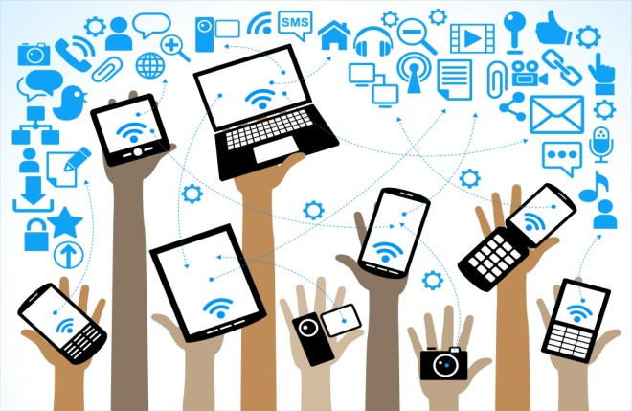
BYOD Student Presentation
Fourth Grade

Slide 2
Table of Contents
What is BYOD?
Devices
Where they can be used?
Where they cannot be used?
When and how they can be used?
Teacher Rights and Responsibilities
Students Rights and Responsibilities
FAQ

Slide 3
What is BYOD?
B = Bring
Y = Your
O = Own
D = Device

Slide 4
Tablet
Smart Phone
Laptop/ Netbooks
MP3 Players
E-Readers
What can you bring?

Slide 5
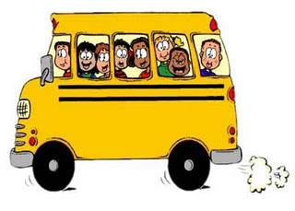
Where you can use them ….
Classroom
Bus

Slide 6
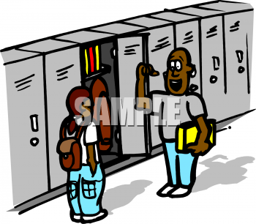
Where you canNOT use them…
Bathroom
Cafeteria
Hallway
Outdoor Recess

Slide 7
When/How you can use it…
When your teacher has indicated.
How your teacher has directed.

Slide 8
Teacher’s Rights/Responsibilities
Can tell you to put it away at anytime.
Does not have to use it during instruction.
Are NOT responsible for any lost or damage

Slide 9
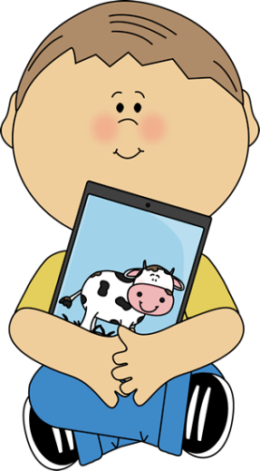
Student’s Rights/ Responsibilities
With permission bring an approved device.
Solely responsible for it at all times
Responsible for any damage or lost
Ensuring no one else use it
Fully charged before school (Cannot charge at school)

Slide 10
FAQ
Can I take pictures and videos?
With teacher permission
Can I take it to specials?
Yes, but it is your responsibility
Can I contact my parent during the day?
No. You may not email or text during the day.
Will I be able to connect to the internet?
Yes, through CCPS Wi-Fi. It has the same filter as any of the school computers.
Do I need more own headphones?
Yes. You will need to have your own headphones to listen to any audio.
Can I bring more than one device?
Yes, but you are responsible for anything that you bring.

